Slide 1
GitHub Actions
GitHub
Philips Dev Days

Slide 2
GitHub Actions Overview
Notes:
GitHub Actions is a CI/CD (Continuous Integration/Continuous Deployment) platform for automating software workflows, including building, testing, and deploying code, directly within GitHub. It allows developers to automate tasks, integrate with other tools and services, and create custom CI/CD pipelines that can be triggered by events such as code pushes, pull requests, and issues. It is used to automate the software development process, improve collaboration and productivity, and ensure that code is tested and deployed consistently and efficiently.

Slide 3
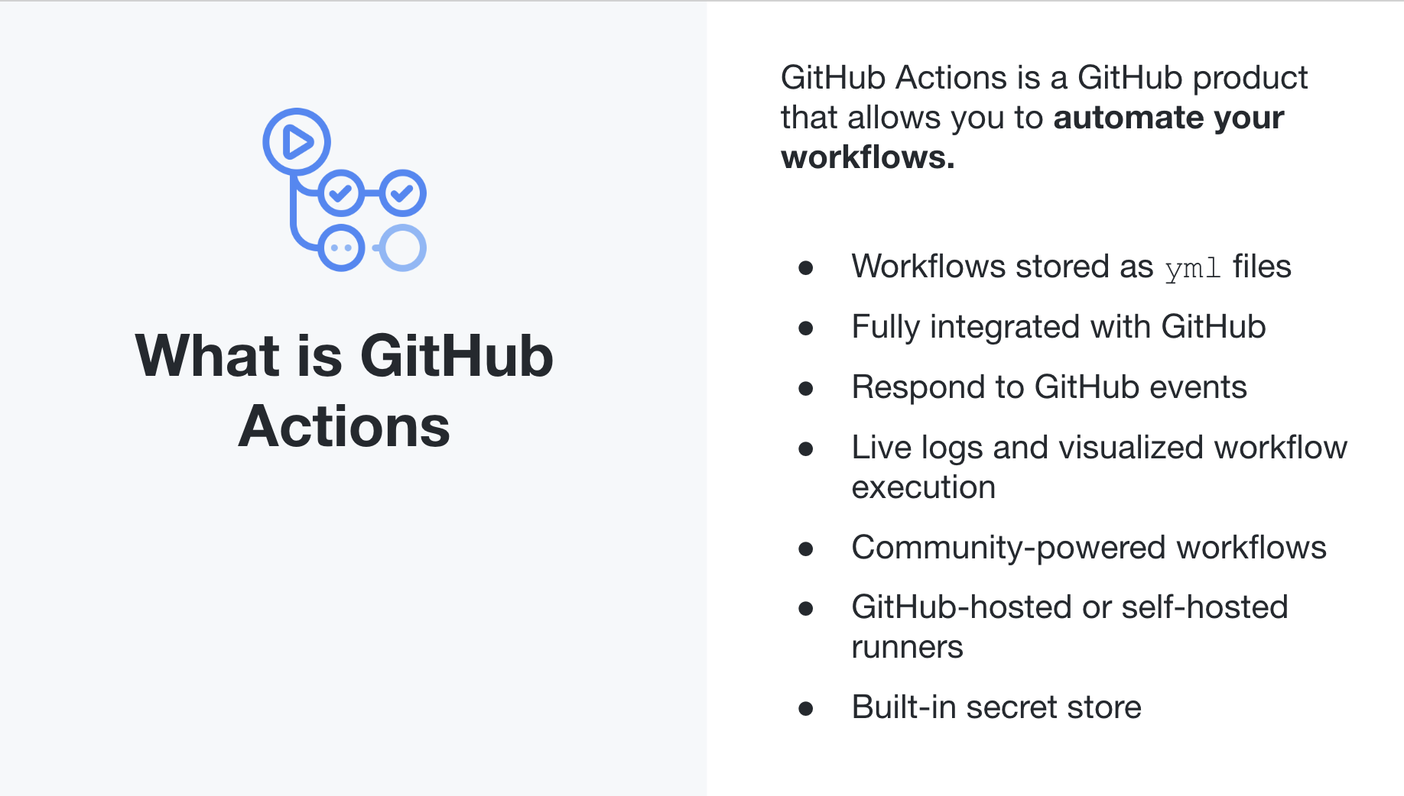
Notes:
GitHub Actions is a CI/CD (Continuous Integration/Continuous Deployment) platform for automating software workflows, including building, testing, and deploying code, directly within GitHub. It allows developers to automate tasks, integrate with other tools and services, and create custom CI/CD pipelines that can be triggered by events such as code pushes, pull requests, and issues. It is used to automate the software development process, improve collaboration and productivity, and ensure that code is tested and deployed consistently and efficiently.

Slide 4
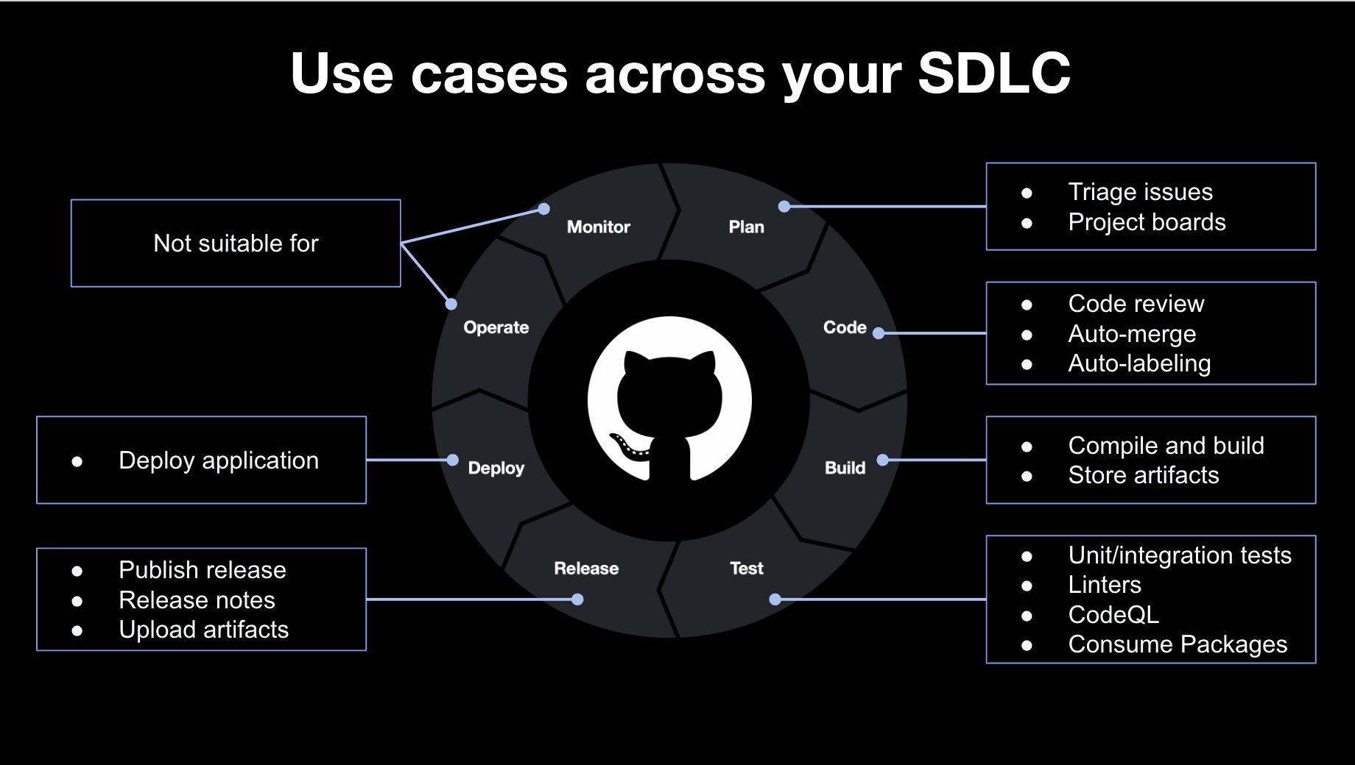
Notes:
GitHub Actions allows you to address different use cases across your software development lifecycle

Slide 5
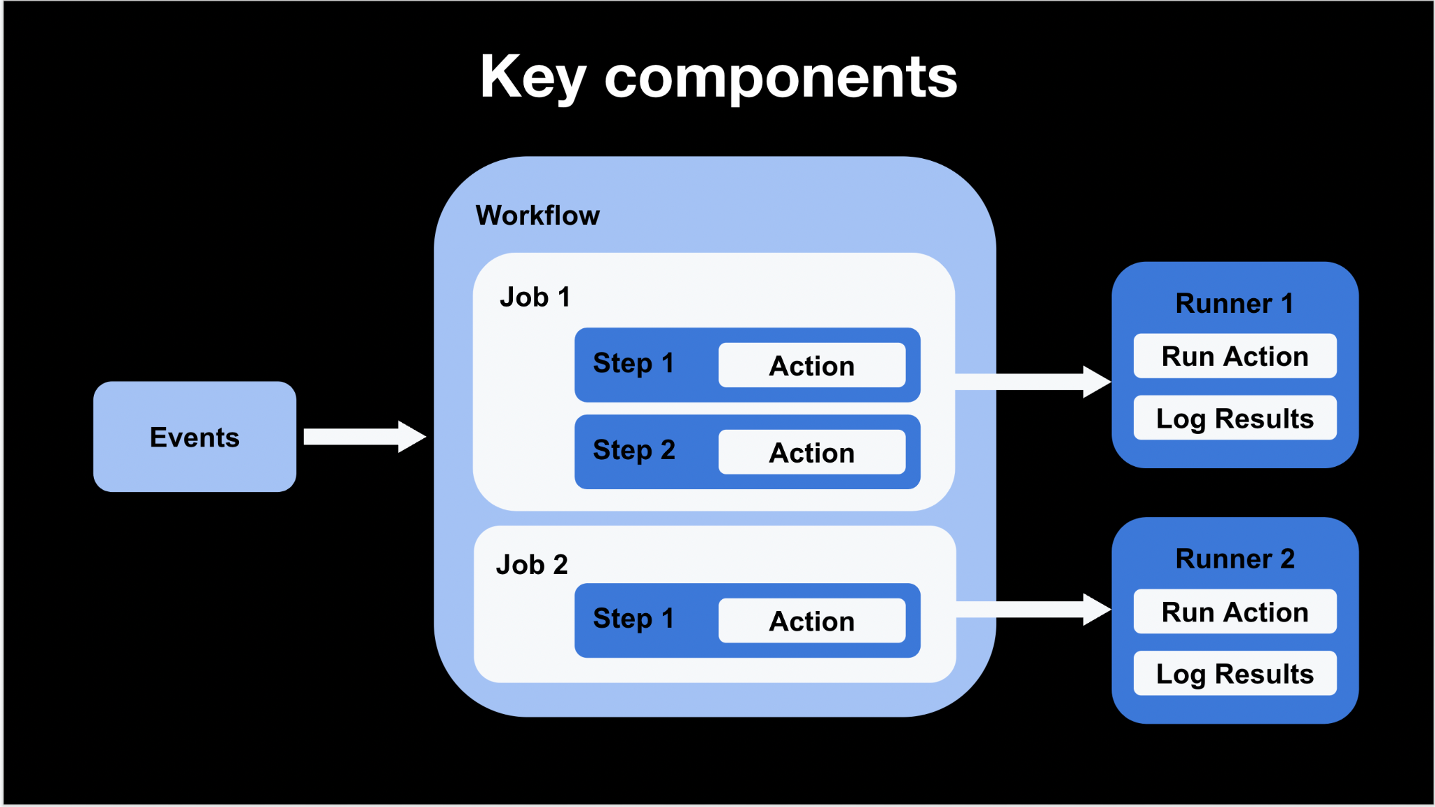
Notes:
At a high level, here are the components of GitHub Actions:
An event is a specific activity that triggers a workflow, for example a commit to a branch
A workflow contains one or more jobs
A job contains one or more steps, each step is an individual task that can execute code
A step can execute shell code directly, or reference an Action written in for example Javascript
Each job executes on a runner
A runner is the environment where the job is execute. Each step in a job executes on the same runner, allowing the actions in that job to share data with each other
You can use a runner hosted by GitHub, or you can host your own
A runner listens for available jobs, runs one job at a time, and reports the progress, logs, and results back to GitHub

Slide 6
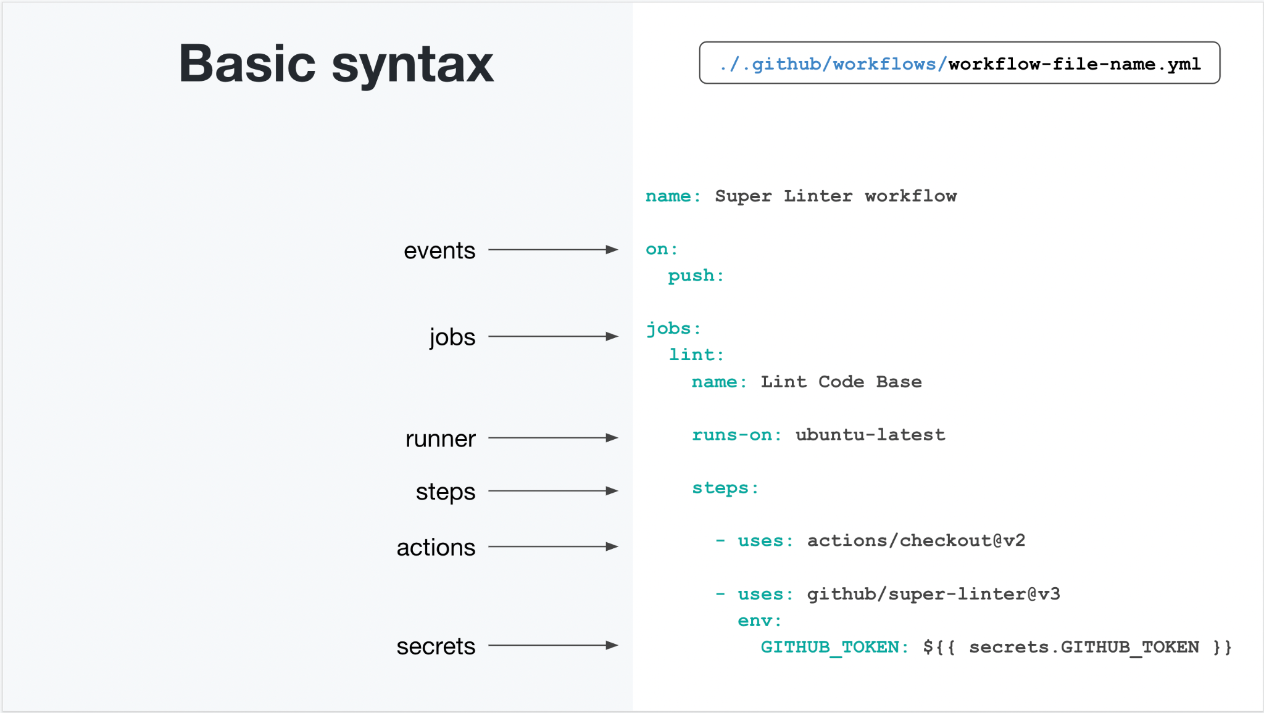
Notes:
Let’s take a closer look intothe basic syntax of GitHub Actions workflows
Workflows are written in YAML syntax and must be created in the .github/workflows directory
If you are already using something like TravisCI or CircleCI, then you are probably familiar with YAML
The slide shows a workflow that has one event trigger, one job, and two steps
This workflow will trigger on push events (i.e. commits) to any branch
If will trigger one job (lint) which runs on a GitHub-hosted Ubuntu runner
The job will execute two steps: one Action that checks out the current repository, and one Action that lints the code in that repository
In the linter Action, you can also see that we set a secret as an environment variable which is accessible to that step

Slide 7
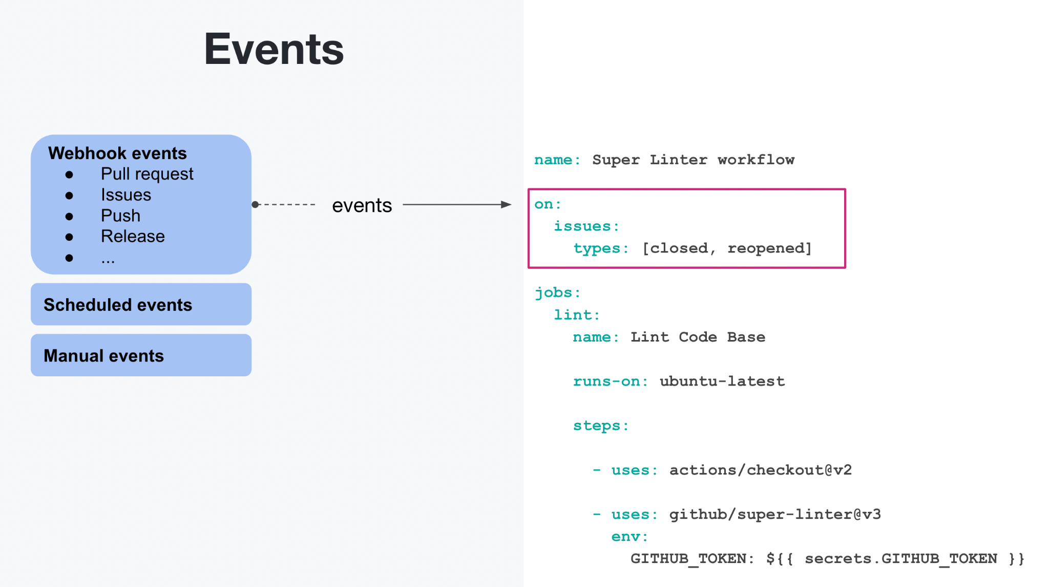
Notes:
We have three types of events: webhook events, scheduled events, and manual events
The first one we’ll address is webhook events:
Webhooks might already be familiar to you if you’ve built other integrations with GitHub
Webhooks allows you to listen for events in GitHub, and if that event occurs; send a payload with the event details to some endpoint
GitHub Actions works in the same way, and you can define which webhook events you want to listen for to trigger your workflow
We currently have 27 different webhook events we can use to trigger workflows, for example pull request events, issue events, releases, push events, wiki events, fork events, etc
In your workflow you can define multiple events, and you can also filter on specific types
For example, the workflow in the slide will only run if an issue is either closed or reopened. It will not trigger if a new issue is created

Slide 8
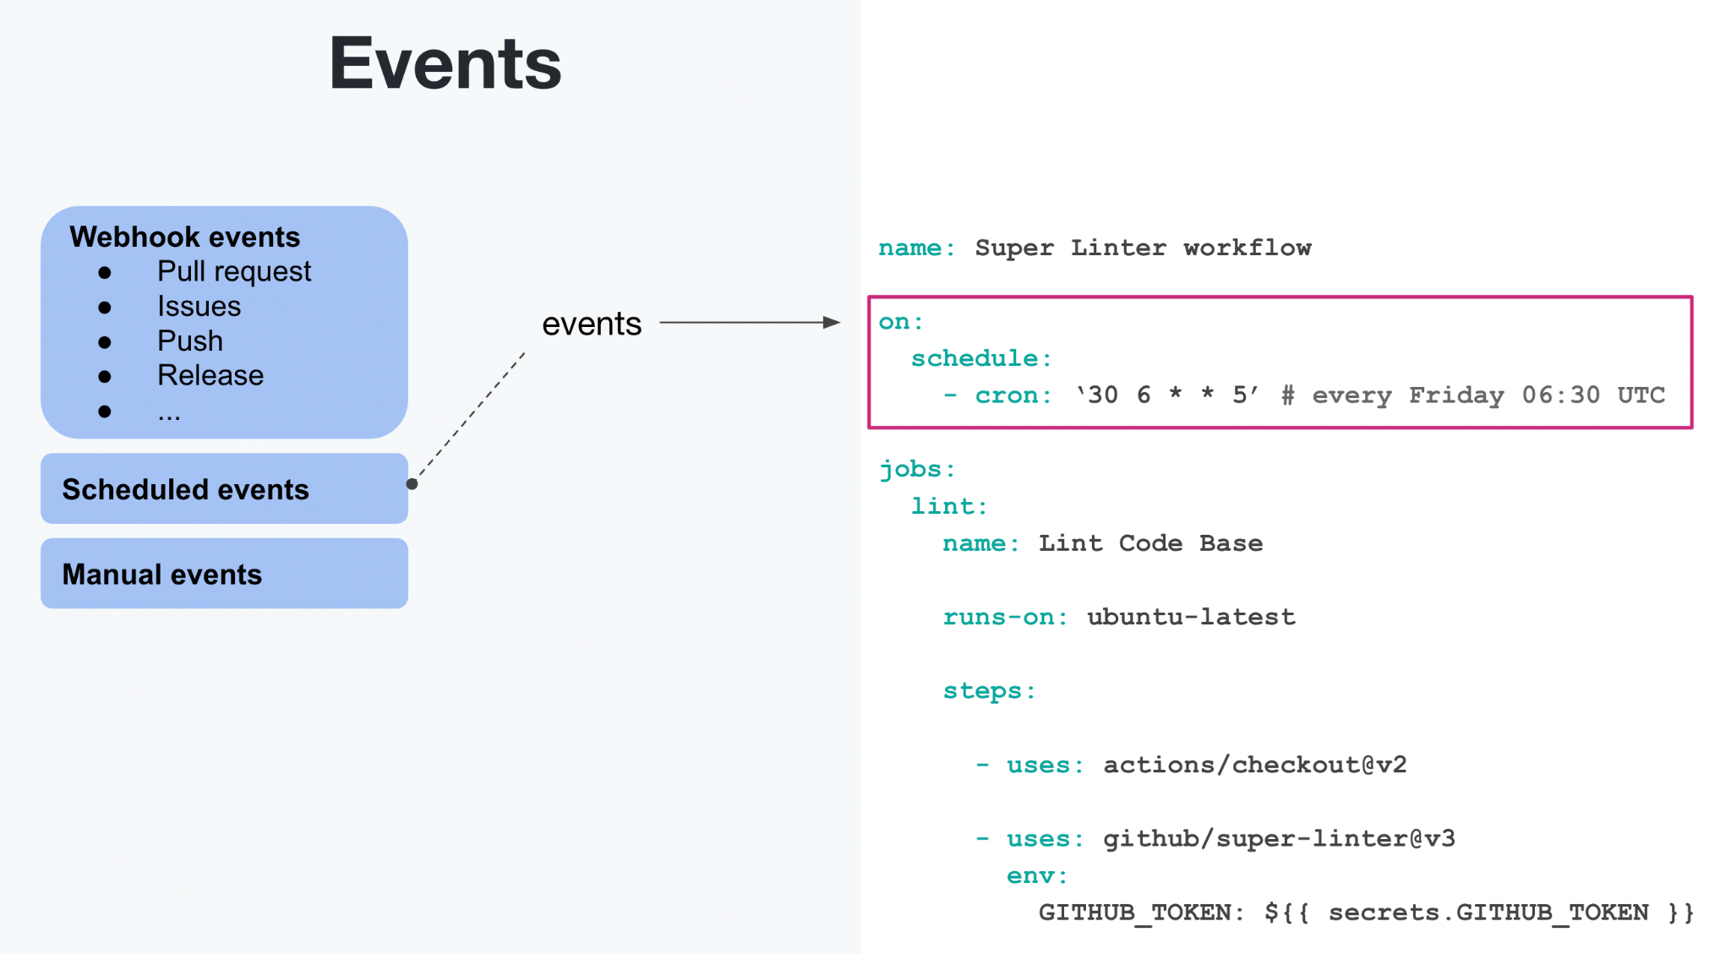
Notes:
Scheduled events allow you to trigger a workflow on a cron schedule:
We only support cron syntax
One workflows cannot be scheduled with less than a 5 minute interval
Scheduled events can for example be used for things like long-running regular builds, generating regular reports, etc
Note: if you use a GitHub hosted runner, we do not guarantee execution of the workflow at the exact time specified. It depends on availability of our runner machines
The top of the hour is the most common cron schedule, so in case you experience delays you can try scheduling at alternative times such as 15 min past the hour instead
See this page to get familiar with the cron syntax: https://crontab.guru

Slide 9
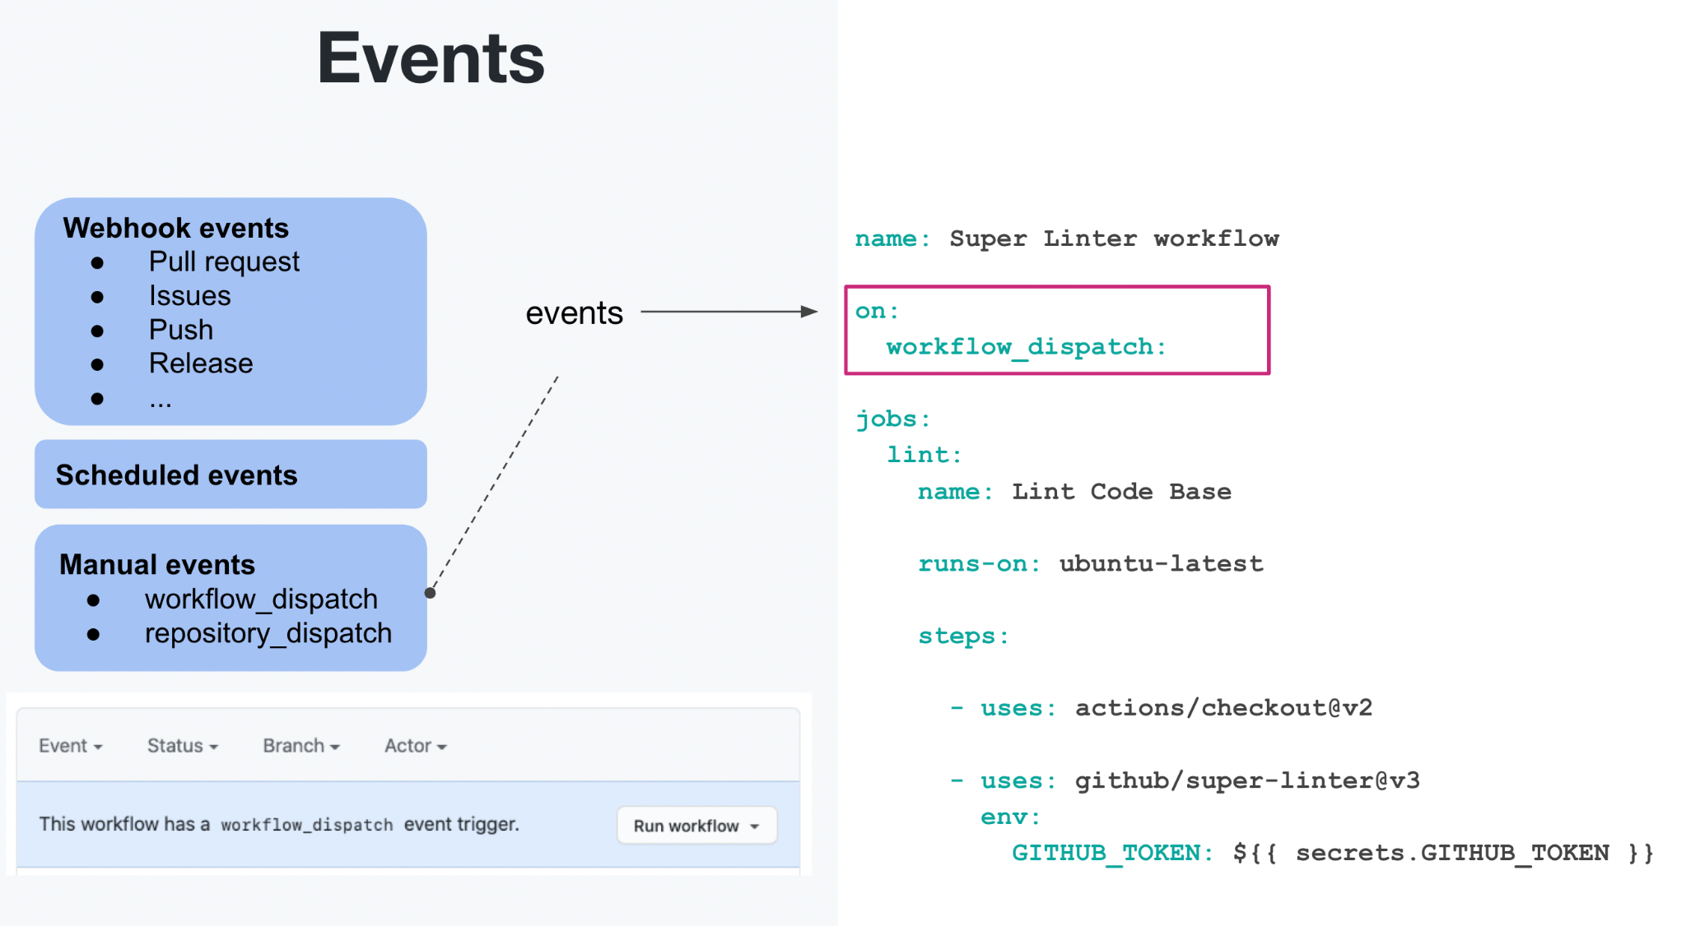
Notes:
Manual events allows you trigger a workflow on demand
We support two types of events; “workflow_dispatch” and “repository_dispatch”
workflow_dispatch
Trigger a workflow via the GUI, the GitHub API, and/or the GitHub CLI
You can define a set of input parameters that can be accessed by the workflow
Use this event to trigger a specific workflow, to trigger multiple workflows manually
repository_dispatch
Trigger a workflow, or multiple workflows in a repository, using the GitHub API
You can define a custom API payload that can be accessed

Slide 10
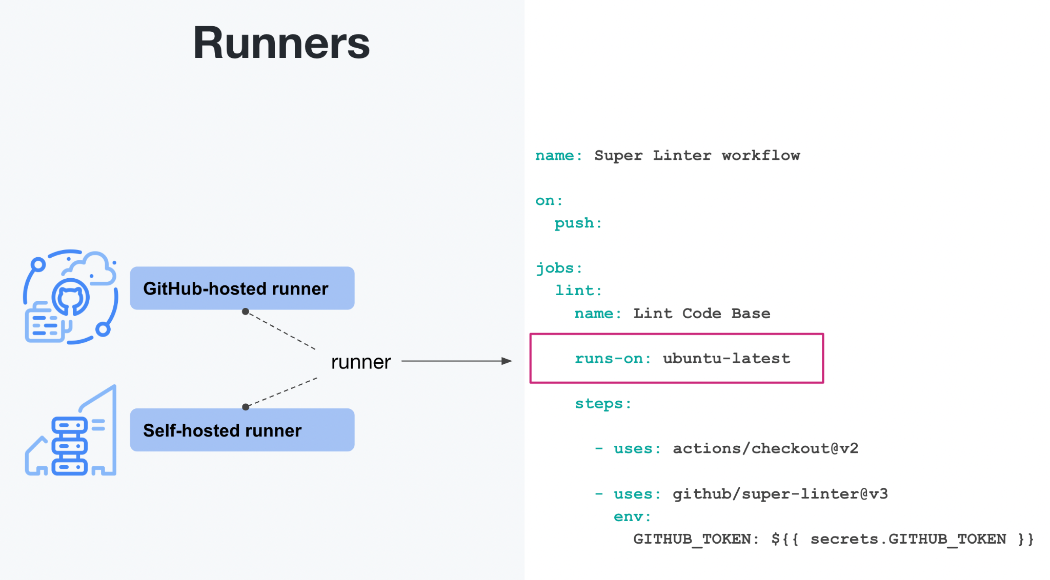
Notes:
Let’s talk about runners
Runners provide the execution environment for workflow jobs
We have two types of runners: GitHub-hosted and self-hosted
GitHub-hosted runners provide the execution environment as a service and are subject to billing
Self-hosted runners are managed yourself, and provide more options for custom specs if needed

Slide 11
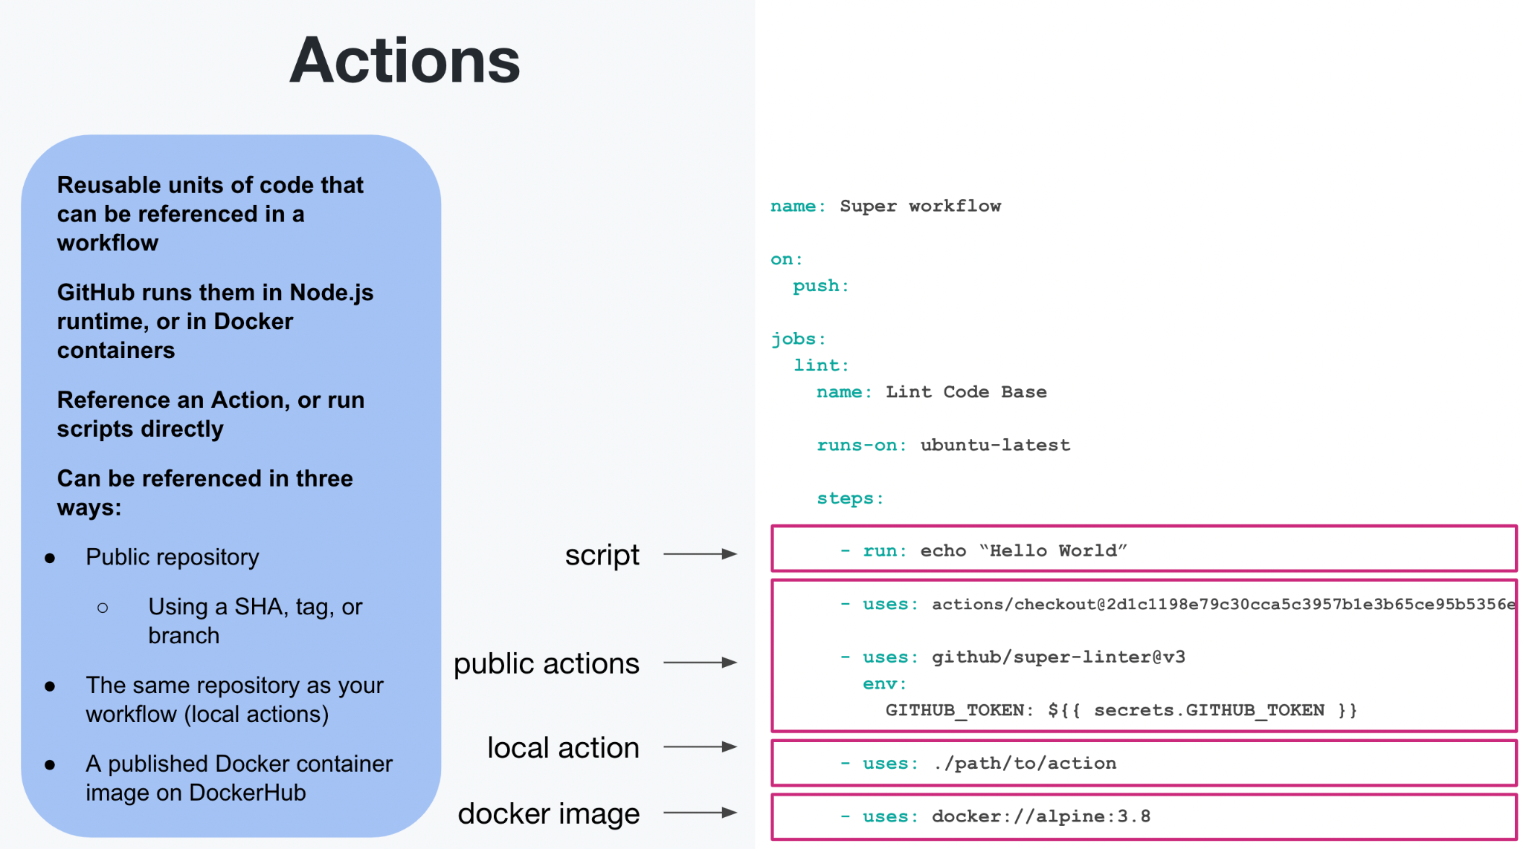
Notes:
Important to note that Jobs run in parallel (by default) on their own runners, but you can identify that specific jobs need the results from other jobs before it can begin using the “needs” tag
As the final part of this introduction, let’s have a look at the steps, which is where we can invoke Actions:
GitHub Actions are reusable units of code that can be referenced from multiple workflows
Run natively on Node.js, you can write an Action in JavaScript, or anything that compiles to JavaScript (TypeScript) and it will just run natively on GitHub-hosted runners
Run any shell command directly in your workflow
GitHub-hosted runners come with a set of preinstalled software, and you can invoke any of these tools directly using the `run:` syntax
For example, GitHub CLI comes pre-installed so you can run the `gh <command>` directly
Three ways to reference an Action
If you are invoking an Action from a different repository than the workflow, then that Action must be in a public repository
We don’t support invoking Actions from private or internal repositories yet, however there are workarounds to this use case <- CHECK THIS
Actions that exist in the same repository as the workflow can be referenced using the `./` syntax
Published Docker images can also be referenced directly on ghcr, docker hub, or any public repository

Slide 12
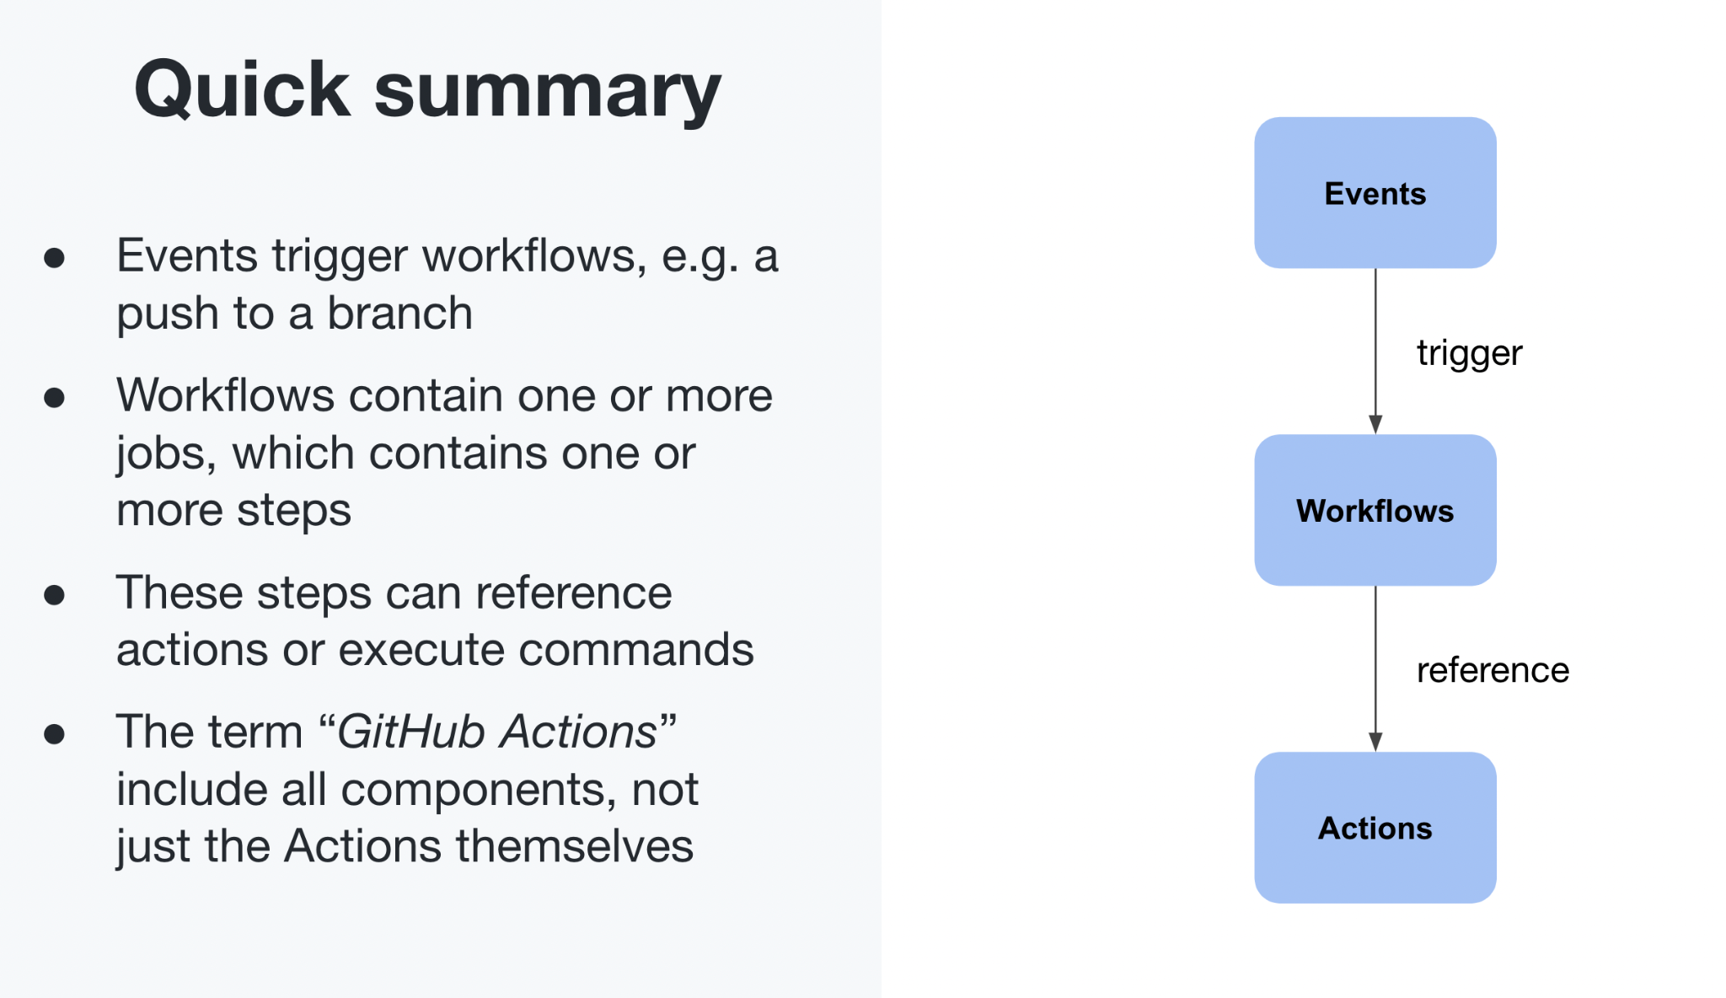
Notes:
GitHub actions is the entire concept, not just the Actions itself

Slide 13
Securing GitHub Actions / Best Practices

Slide 14
General tips
Create small actions that do one thing and they do it well
Integrate with the tools you use
Leverage the community
Add an Action badge to your README
Notes:
Preferred language bullet: Actions run in Docker containers, so you can setup your Actions based on your language preference using the right Docker image
Leverage the community: use Actions from the GitHub marketplace, the workflow repository, or directly from Docker Hub

Slide 15
Security
Use actions pinning or a tag
Update Actions frequently to get the latest security patches
Never add tokens or keys without encryption
Set the default workflow permissions to contents:read
Require the GITHUB_TOKEN permissions be set at the workflow level
Notes:
Use actions pinning or a tag: Instead of just using the latest version of an action, you can leverage the action at a specific point in its history by leverage actions pinning or specify the tag to leverage when calling the action
Pinning an action to a full length commit SHA is currently the only way to use an action as an immutable release. Pinning to a particular SHA helps mitigate the risk of a bad actor adding a backdoor to the action's repository, as they would need to generate a SHA-1 collision for a valid Git object payload.
Enable dependabot with actions; https://docs.github.com/en/code-security/dependabot/working-with-dependabot/keeping-your-actions-up-to-date-with-dependabot

Slide 16
Reusability and workflow sharing
Custom Actions
Reusable workflows

Slide 17
Custom Actions
If there is a single step you want to be able to reuse (think unix philosophy). If you have other code/scripts you want to pull in to the pipeline to run
There’s three different types of custom Actions

Slide 18
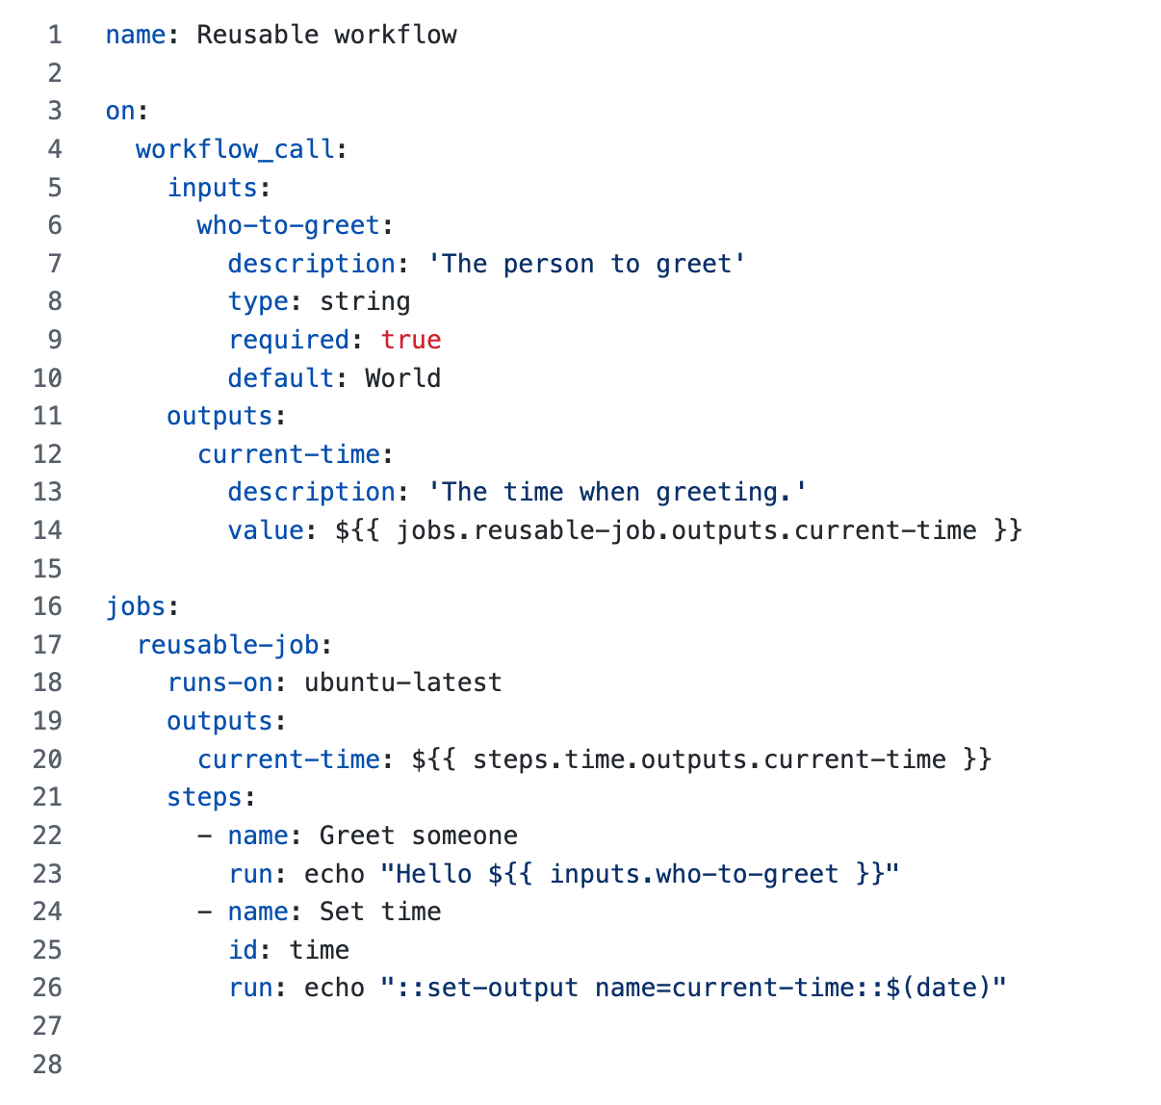
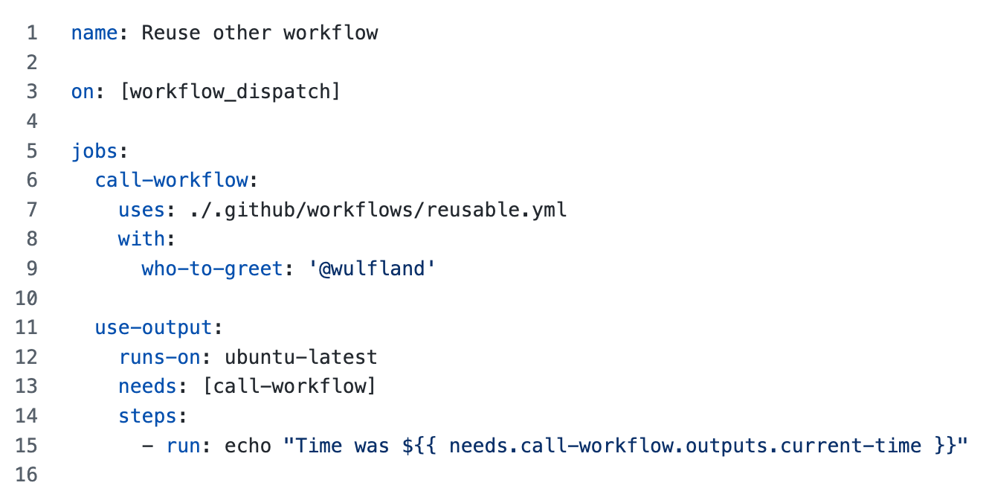
Reusable workflows
Notes:
Regular workflow
But it is decorated with this specific details to make it a reusable workflow
Secrets must be passed into the reusable workflow from the calling workflow. The reusable workflow doesn't have direct access to the secrets in it's own source repository.

Slide 19
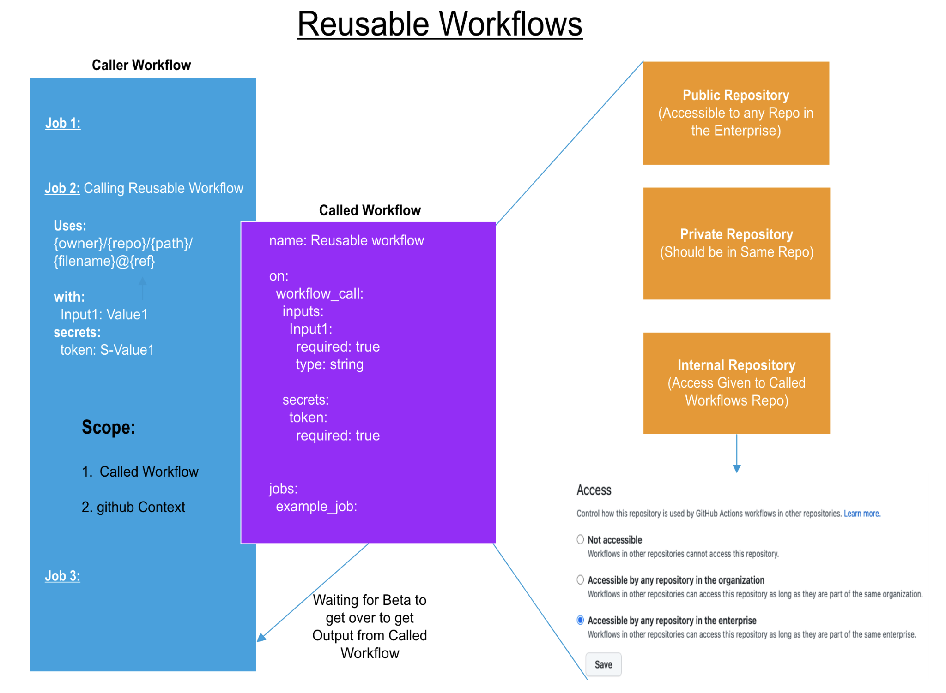

Slide 20
Reusable workflow vs Composite action
Reusable workflow:
Defines the entire job
Can enforce runner labels
No option to do something before and after the steps
Composite action:
Defines the list of steps
Full flexibility to do something before and after the steps in the composite action
https://github.blog/developer-skills/github/using-reusable-workflows-github-actions/
Notes:
Reusable Workflows
Scope: Reusable workflows allow you to reuse an entire workflow, including jobs, steps, and actions. This means you can define a common CI/CD process and use it across multiple repositories within an organization.
Usage: They are referenced from another workflow using the uses keyword with the workflow file path and reference (branch, tag, or commit SHA).
Flexibility: Reusable workflows can accept inputs and can return outputs. They can be triggered by the same events that trigger regular workflows, such as push, pull request, or manual triggers.
Isolation: When you call a reusable workflow, it runs as a separate entity. This means it has its own queue and execution context, separate from the calling workflow.
Composite Actions
Scope: Composite actions allow you to combine multiple steps into a single action. This is useful for packaging scripts and shell commands that can be reused across jobs in the same workflow.
Usage: They are used within a job in a workflow file, allowing you to abstract and reuse parts of your jobs. Composite actions are defined in a repository and referenced using the uses keyword with the action's repository path and reference.

Slide 21

Sharing workflows
Best Practices
Use actions and composite actions as building blocks
Use workflow templates and template repositories for discoverability
Use reusable workflows for complex scenarios and for standardization
Share actions and reusable workflows in internal repositories

Slide 22
Actions in an organization
Use the GITHUB_TOKEN when possible, as a second option, GitHub Apps
Limit token permissions
Run only trusted actions
Protect your secrets with environments
Create starter workflows for reusability
Use actions for CI/CD but also *-ops
Notes:
GitHub token and billing implications
Token limit scope
Trusted actions settings recommendations
Environments and the protection of secrets
Reusability with started workflows
Meaningful readme’s have: what it does, example, parameters, how to test/run locally, contributing guidelines and licenses
When creating actions make them focused and reuse from the marketplace
https://practices-knowledge-base.githubapp.com/3-actions/actions-best-practices/

